Slide 1
Mobile Phone Price Range Classification
Classification Project
Notes:
ID=d924773e-9a16-4d6d-9803-8cb819e99682 Recipe=text_billboard Type=TextOnly Variant=0 FamilyID=AccentBoxWalbaum_Zero

Slide 2
Mobile Phone Price Range Classification
Introduction
In today's competitive smartphone market, mobile phones come in various price ranges—such as budget, mid-range, and flagship—depending on features like RAM, battery life, screen size, processor speed, and camera quality. Understanding which features influence the price category of a phone is valuable for manufacturers, retailers, and even customers who want to make informed buying or selling decisions.
In this project, we built a classification model to predict the price range category of a mobile phone based on its specifications. Instead of predicting the exact price, the model classifies phones into categories: low cost, medium cost, high cost, or premium. This is helpful when you want to group phones for comparison or target specific market segments.
Once the data was ready, we trained and tested several classification models to see which one performed the best. We used evaluation metrics like accuracy, confusion matrix, and classification report (precision, recall, and F1-score) to measure how well each model predicted the price range.
The final result is a model that can predict the price category of a mobile phone based on its features. This kind of system can be useful in online mobile shops, price comparison websites, or even during the product design phase for manufacturers.

Slide 3
Regression Project
Preprocessing Steps

Slide 4
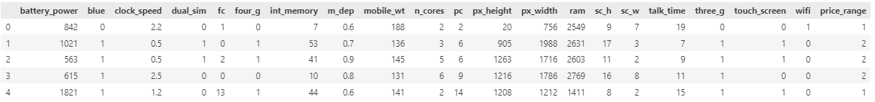
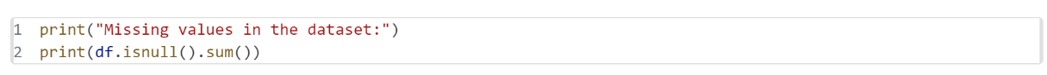
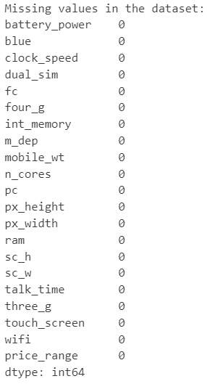
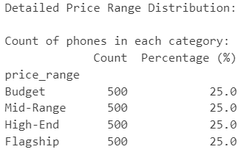

Slide 5
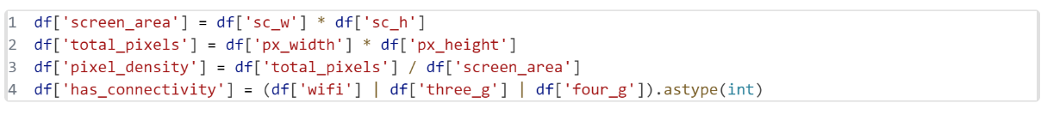
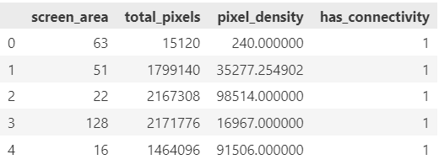
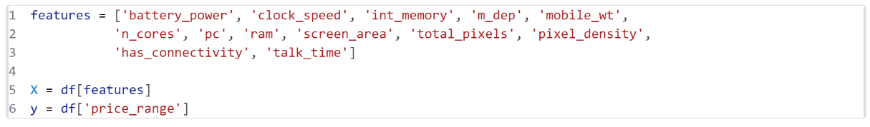
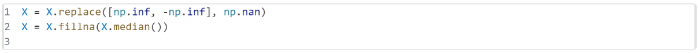

Slide 6
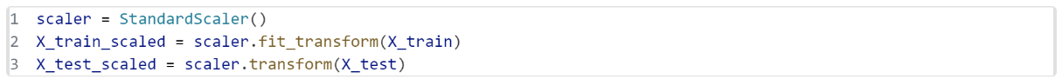
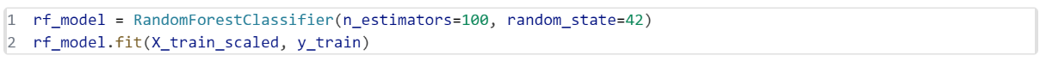
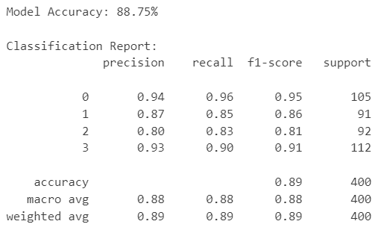
Model Selection & Evaluation

Slide 7
Key Findings
RAM and internal memory were among the most important features in determining the price category. Phones with higher RAM and storage generally fell into higher price ranges.
Battery power, pixel resolution, and the presence of 4G/3G connectivity also strongly influenced whether a phone was classified as budget, mid-range, or premium.
Outliers and missing values were minimal in the dataset, which made preprocessing straightforward.
The classification model with the best performance was able to accurately predict the price range of most phones, with high precision and recall scores across all categories.
Confusion Matrix and Classification Report showed that the model performed especially well in distinguishing between low-cost and high-cost phones, with some overlap between mid-range and adjacent categories.
Among the models tested, algorithms like Random Forest or Gradient Boosting generally outperformed simpler models like Logistic Regression in terms of overall accuracy.

Slide 8
Conclusion
In this project, we successfully built a classification model that can predict the price range of mobile phones based on their specifications. Through careful data analysis, feature engineering, and model evaluation, we found that features such as RAM, memory, battery, and connectivity options play a key role in determining whether a phone is categorized as low-cost, mid-range, or premium.
Our best-performing model achieved strong classification metrics and can be useful for various applications like e-commerce product sorting, mobile comparison tools, or even helping manufacturers position their devices in the right price segment.
This project demonstrates how machine learning can provide valuable business insights and automate classification tasks in a structured and data-driven way.

